Slide 1

Classification Problem in Machine Learning
Dr. Basharat Mahmood
Dr. Madiha Yousuf
Department of Computer Science, COMSATS University Islamabad

Slide 2
Classification Problem in Machine Learning
Classification is a supervised learning problem where the goal is to predict categorical labels based on input features.
Essentially, it involves assigning each input data point to one of several predefined categories.
Medical Diagnosis: Predicting whether a patient has a specific disease based on diagnostic features (e.g., predicting cancer presence from medical images).
Customer Churn Prediction: Identifying customers who are likely to stop using a service based on their usage patterns.
Sentiment Analysis: Classifying text data as expressing positive, negative, or neutral sentiment.
Handwriting Recognition: Identifying characters or words from handwritten text.

Slide 3
Classification Problem in Machine Learning
Common Classification Algorithms
Logistic Regression: A linear model used for binary classification problems. It predicts the probability of a binary outcome.
Decision Trees: A model that splits the data into subsets based on feature values, creating a tree-like structure of decisions. It is easy to interpret but can overfit the training data.
Random Forest: An ensemble method that combines multiple decision trees to improve performance and reduce overfitting. Each tree is trained on a random subset of the data.
Support Vector Machines (SVM): Finds the hyperplane that best separates the classes in the feature space. It works well in high-dimensional spaces and with clear margins of separation.
K-Nearest Neighbours (KNN): Classifies a data point based on the majority class among its k-nearest neighbours in the feature space. It is simple but can be computationally expensive.

Slide 4
Logistic Regression
Logistic Regression is a statistical method used for binary classification tasks in machine learning.
It is employed to predict the probability that a given input belongs to a particular class.
Despite its name, logistic regression is a classification algorithm, not a regression algorithm.
Objective: Logistic regression predicts the probability of a binary outcome (e.g., yes/no, true/false) based on one or more predictor variables (features).
Output: The output of a logistic regression model is a probability score between 0 and 1, which is then mapped to one of two classes.
Probability < 0.5: If the predicted probability is less than 0.5, the instance is classified into Class 0 (the negative class).
Probability ≥ 0.5: If the predicted probability is equal to or greater than 0.5, the instance is classified into Class 1 (the positive class).

Slide 5
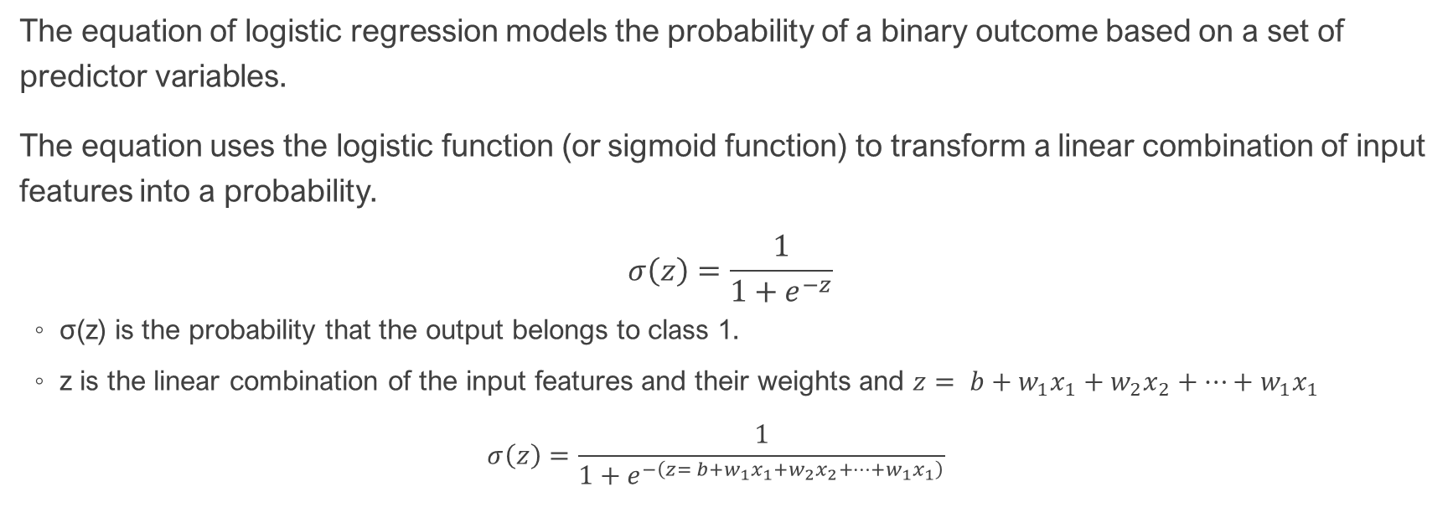
Logistic Regression: Mathematical Model
The equation of logistic regression models the probability of a binary outcome based on a set of predictor variables.
The equation uses the logistic function (or sigmoid function) to transform a linear combination of input features into a probability.
$$σ\left(z\right)=\frac{1}{1+e^{−z}}$$
σ(z) is the probability that the output belongs to class 1.
z is the linear combination of the input features and their weights and $z= {b+w}_{1}x_{1}+w_{2}x_{2}+…+w_{1}x_{1}$
$$σ\left(z\right)=\frac{1}{1+e^{−\left(z= {b+w}_{1}x_{1}+w_{2}x_{2}+…+w_{1}x_{1}\right)}}$$

Slide 6

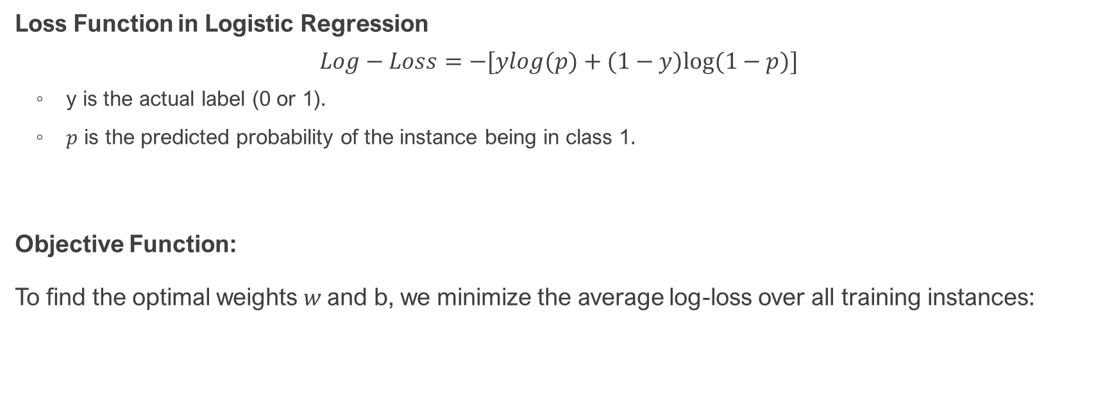
Logistic Regression: Objective Function
Loss Function in Logistic Regression
$$Log−Loss=−[ylog(p)+(1−y)log⁡(1−p)]$$
y is the actual label (0 or 1).
$p$ is the predicted probability of the instance being in class 1.
Objective Function:
To find the optimal weights $w$and b, we minimize the average log-loss over all training instances:

Slide 7
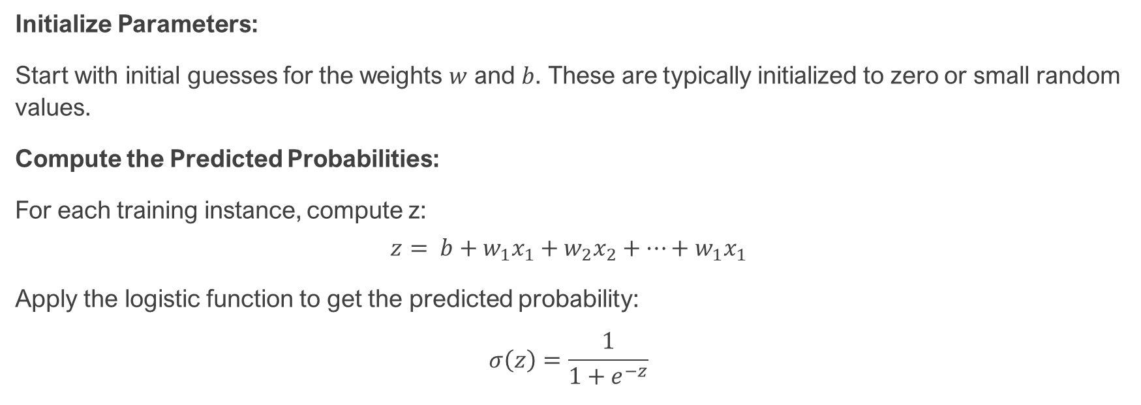
Logistic Regression: Process
Initialize Parameters:
Start with initial guesses for the weights $w$ and $b$. These are typically initialized to zero or small random values.
Compute the Predicted Probabilities:
For each training instance, compute z:
$$z= {b+w}_{1}x_{1}+w_{2}x_{2}+…+w_{1}x_{1}$$
Apply the logistic function to get the predicted probability:
$$σ\left(z\right)=\frac{1}{1+e^{−z}}$$

Slide 8

Logistic Regression: Process …
Calculate the Log-Loss (Cross-Entropy Loss):
For each instance, compute the log-loss:
$$Log−Loss=−[ylog(p)+(1−y)log⁡(1−p)]$$
Compute the average loss

Slide 9


Logistic Regression: Process …
Compute Gradients:
Calculate the gradient of the log-loss with respect to each weight and the bias term:

Slide 10


Logistic Regression: Process…
Update Parameters:
Adjust the weights and bias using the gradients and a learning rate α\alphaα:
Iterate:
Repeat the process of calculating predictions, computing the log-loss, calculating gradients, and updating parameters until the changes in log-loss are below a specified threshold or a maximum number of iterations is reached.
Solved Example
Code Example

Slide 11
Logistic Regression: Multi-class Classification
Logistic Regression can handle multi-class classification problems using a method known as One-vs-Rest (OvR) or One-vs-One (OvO).
One-vs-Rest (OvR):
For a multi-class classification problem with k classes, OvR fits k separate binary classifiers.
Each classifier distinguishes one class from all the other classes.
During prediction, the classifier with the highest confidence score decides the final class.
Sklearn uses this method to handle multi-class classification.
One-vs-One (OvO):
For k classes, OvO fits k(k−1)/2​ binary classifiers.
Each classifier distinguishes between a pair of classes.
During prediction, a voting scheme is used to decide the final class.

Slide 12
Decision Tree
I
A decision tree is a versatile and intuitive machine learning algorithm used for both classification and regression tasks.
It models decisions and their possible consequences using a tree-like structure.
Color
green
red
blue
Size
+
Shape
big
small
square
round
-
+
Size
+
big
small
-
+
12

Slide 13
Decision Tree: Structure
Root Node: The topmost node in the tree that encompasses the entire dataset. It splits based on the feature that provides the best separation.
Decision Nodes: Nodes that test a feature or a condition and branch out to other decision nodes or leaf nodes based on the test results.
Branches: The lines connecting decision nodes and leaf nodes, representing the outcome of a decision or test.
Leaf Nodes (Terminal Nodes): The end points of the tree that provide the final decision or prediction. In classification tasks, they represent class labels; in regression tasks, they represent predicted values.
The depth of a decision tree refers to the number of levels from the root node to the deepest leaf node.

Slide 14
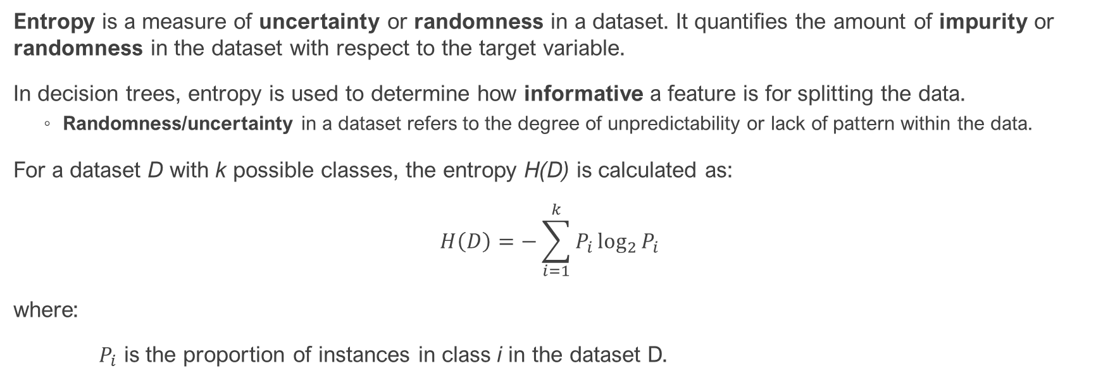
Decision Tree: Concepts
Entropy is a measure of uncertainty or randomness in a dataset. It quantifies the amount of impurity or randomness in the dataset with respect to the target variable.
In decision trees, entropy is used to determine how informative a feature is for splitting the data.
Randomness/uncertainty in a dataset refers to the degree of unpredictability or lack of pattern within the data.
For a dataset D with k possible classes, the entropy H(D) is calculated as:
$$H\left(D\right)=−\sum_{i=1}^{k}{P_{i}\log_{2}{P_{i}}}$$
where:
$P_{i}$​ is the proportion of instances in class i in the dataset D.

Slide 15
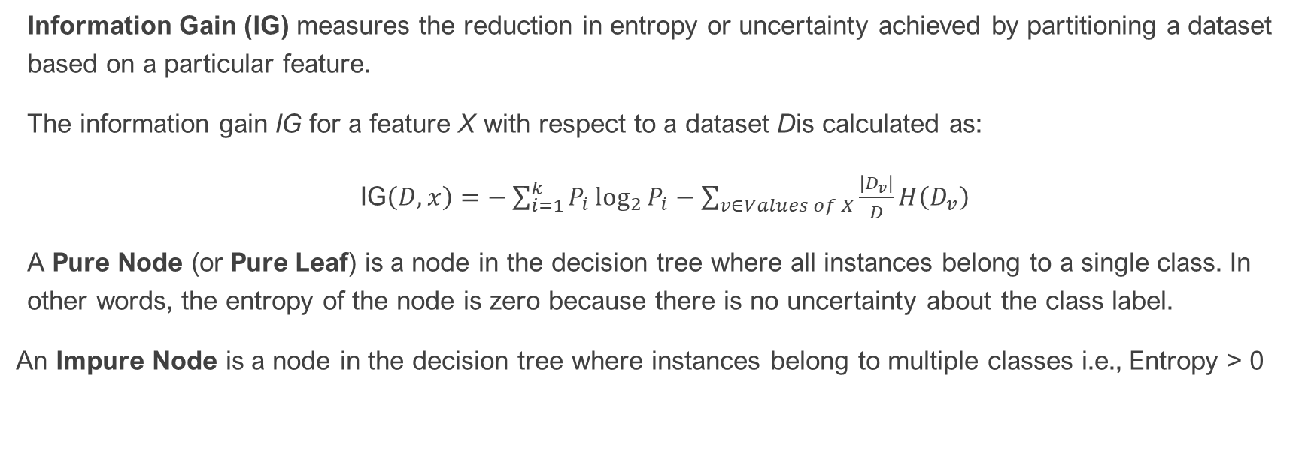
Decision Tree: Concepts …
Information Gain (IG) measures the reduction in entropy or uncertainty achieved by partitioning a dataset based on a particular feature.
The information gain IG for a feature X with respect to a dataset Dis calculated as:
IG$\left(D,x\right)=−\sum_{i=1}^{k}{P_{i}\log_{2}{P_{i}}−\sum_{v∈Values of X}{\frac{\left|D_{v}\right|}{D}H\left(D_{v}\right)}}$
A Pure Node (or Pure Leaf) is a node in the decision tree where all instances belong to a single class. In other words, the entropy of the node is zero because there is no uncertainty about the class label.
An Impure Node is a node in the decision tree where instances belong to multiple classes i.e., Entropy > 0

Slide 16
Decision Tree: Building the Decision Tree
Define the Problem
Identify the Task: Determine whether you are solving a classification or regression problem.
Gather Data: Collect a dataset relevant to the problem.
Prepare the Data
Feature Selection: Choose which features (attributes) will be used to split the data.
Data Cleaning: Handle missing values, remove outliers, and preprocess data as needed.
Encoding: Convert categorical variables into numerical form if required.

Slide 17
Decision Tree: Building the Decision Tree …
Choose a Splitting Criterion
For Classification: Common criteria include:
Gini Impurity: Measures the impurity of a split. Lower values indicate purer nodes.
Entropy: Measures the amount of uncertainty or disorder. The goal is to reduce entropy after a split.
For Regression: Common criteria include:
Mean Squared Error (MSE): Measures the variance within the subsets. The goal is to minimize MSE.

Slide 18
Decision Tree: Building the Decision Tree …
Build the Tree
Start at the Root Node:
Select the Best Feature: Use the chosen criterion to determine which feature and threshold (cut-off point) best split the data.
Create Decision Nodes: Split the dataset into subsets based on the selected feature and threshold.

Slide 19
Decision Tree: Building the Decision Tree …
Recursive Splitting:
Repeat: For each subset, repeat the process of selecting the best feature and splitting the data.
Stopping Criteria: Decide when to stop splitting. Common criteria include:
Maximum Tree Depth: Set a limit on how deep the tree can grow.
Minimum Samples per Node: Set a minimum number of samples required to create a new node.
Minimum Impurity Decrease: Stop if the split does not significantly reduce impurity.
Create Leaf Nodes:
Classify or Predict: For classification, assign the most common class in the subset to the leaf node. For regression, assign the average of the target values in the subset.

Slide 20
Decision Tree: Building the Decision Tree …
Decision Tree Classifier Example
Decision Tree Classifier Code
Decision Tree Regressor Example
Decision Tree Regressor Code

Slide 21
Decision Tree: Pruning
Decision tree pruning is a technique used to enhance the generalization ability of a decision tree model by reducing its complexity.
Pruning involves removing parts of the tree that provide little predictive power, thereby preventing the model from overfitting to the training data.
Overfitting occurs when a model captures noise or random fluctuations in the training data rather than the underlying pattern, leading to poor performance on new, unseen data.

Slide 22
Decision Tree: Pre-pruning
Pre-Pruning (Early Stopping): Pre-pruning involves halting the growth of the tree before it reaches its full size. This technique aims to prevent the tree from becoming overly complex by setting constraints during the tree-building process.
max_depth: Controls the maximum depth of the tree.
min_samples_split: Sets the minimum number of samples required to split an internal node.
min_samples_leaf: Defines the minimum number of samples required at a leaf node.
max_features: Limits the number of features to consider when making a split.
max_leaf_nodes: Restricts the number of leaf nodes in the tree.
min_impurity_decrease: Minimum impurity decrease required to make a split.

Slide 23
Decision Tree: Post-pruning
Post-Pruning: Builds a full tree and then prunes it back by evaluating and removing less significant branches to improve generalization.
Cost Complexity Pruning (also known as CCP Pruning or Weakest Link Pruning) is a technique used to simplify decision trees by removing branches that have little impact on the model's performance.
Cost Complexity Criterion: This criterion is used to measure the trade-off between the tree's complexity, and it’s fit to the training data. The complexity of the tree is penalized based on the number of leaf nodes it has.
Alpha Parameter (ccp_alpha): The ccp_alpha parameter controls the trade-off between tree complexity and training set error. By adjusting ccp_alpha, you can prune the tree to reduce its size and improve its performance on unseen data.

Slide 24
Decision Tree: Post-pruning …
Post-Pruning: Builds a full tree and then prunes it back by evaluating and removing less significant branches to improve generalization.
Steps:
Compute the Cost Complexity: For each subtree in the decision tree, calculate the cost complexity criterion.
Cost Complexity=Training Error+α×Number of Leaf Nodes
Generate a Sequence of Trees: Starting from the full tree, iteratively prune the tree by removing the weakest branches
Select the Optimal Tree: is selected based on the ccp_alpha that achieves the best balance.
Prune the Tree: Apply pruning to the original decision tree using the chosen ccp_alpha.
CCP_Pruning Code

